Slide 1

Major Project -1(CA301P) Odd Semester Session 2025-26 STUDENT BEHAVIOUR ANALYSIS SNIGDHA PRATAP - 2426mca636 TANISHA - 2426mca634 SHRUTI SAGAR - 2426mca1923 TANISHKA SINGH- 2426mca633
Project Incharge:
Dr. Amit Kumar
Mr. Saurabh Chaudhary
Ms. Mahima Tayal
Ms. Shalika
Project Supervisor:
Dr. Neelam Rawat
Ms. Shruti Aggarwal

Slide 2

Student Behaviour Analysis: Predicting Nuisance at College Events
A data-driven approach to enhance campus safety through predictive analytics. Developed by Snigdha Pratap, Tanisha, Shruti Sagar, and Tanishka Singh under the supervision of Dr. Neelam Rawat and Ms. Shruti Aggarwal at KIET Group of Institutions.

Slide 3
The Problem: Unpredictable Disruptions
Safety Concerns
Affected Stakeholders
Current Limitations
Student nuisance behaviors (fighting, vandalism, harassment, intoxication) occur unpredictably at campus events, risking injuries and creating liability.
Attendees, event organizers, campus security, and the wider community. Disruptions deter future participation.
Colleges primarily use reactive measures without data analytics to flag high-risk events in advance.
Modern crowd management is moving toward predictive approaches, but without analytics, organizers cannot identify patterns associated with high nuisance rates.

Slide 4

Project Objectives
Design a database to store historical events and incidents
Develop an analytics model (Python/Pandas, scikit-learn) to compute risk scores for future events
Build a Power BI dashboard to visualize predicted risk categories and historical trends
Shift from reactive security to proactive risk management
Help organizers allocate resources more effectively
The system will support university decision-makers in planning safer events by providing early warning of potential disruptions.

Slide 5
Literature Review Insights
Power BI for Behavior Monitoring
Predictive Analytics in Education
Crowd Safety Prediction
Recent industry analyses emphasize predictive over reactive strategies, with advanced data analytics achieving 80-97% accuracy in forecasting incidents.
Wark (2022) demonstrated using Power BI to integrate multiple behavioral data streams and build dashboards that summarize welfare and detect changes in behavior.
Desouza & Smith (2016) discuss how universities collect broad data on student activities to "nudge" behavior, emphasizing holistic views by integrating various data points.
These studies suggest that applying predictive analytics and dashboards can enhance monitoring and preemptive planning in safety-related settings.

Slide 6



Proposed System Architecture
Historical Data Input
Analytics Model
Power BI Dashboard
Compile past records of college events and documented nuisance incidents in a structured SQL database.
Using Python to preprocess data and train a predictive model (decision tree, random forest, or logistic regression) to output risk scores.
Interactive visualization showing risk categories, incident trends, and filters to explore by demographics or venues.
The system is intended for planning use: organizers input event details, the model assigns a risk score, and the dashboard presents this with related charts.

Slide 7
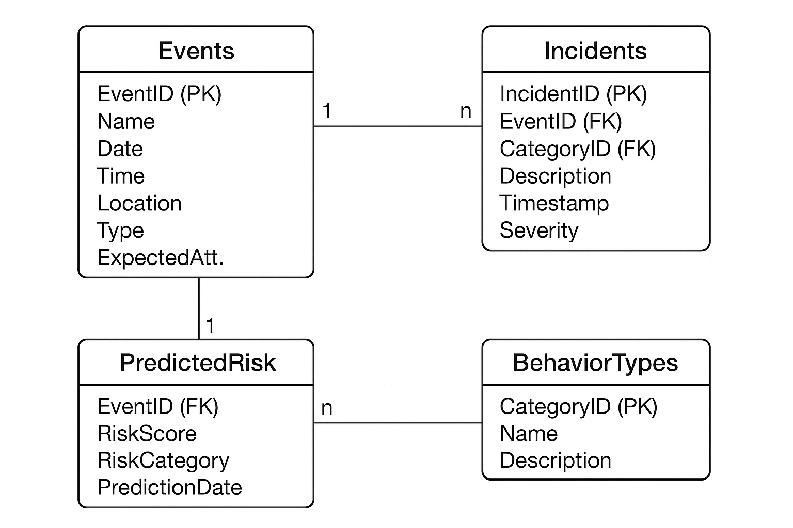
Database Design
Core Tables
Relationships
Events: EventID (PK), Name, Date, Time, Location, Type, ExpectedAttendance
Events 1–n Incidents, and Students 1–n Incidents (if tracking individual offenders). The Predicted Risk table links to Events via EventID.
Incidents: IncidentID (PK), EventID (FK), StudentID (FK), Category, Description, Timestamp, Severity
This design supports queries like "show all incidents for event X" and allows aggregating by event or by behavior type.
Behavior Types: CategoryID (PK), Name, Description
Predicted Risk: EventID (FK), RiskScore, RiskCategory, PredictionDate

Slide 8
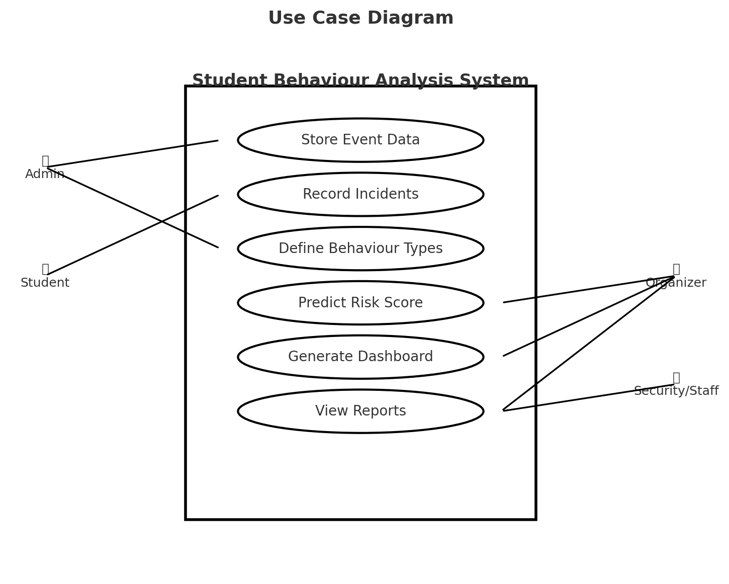
USE CASE
DIAGRAM: STUDENT
BEHAVIOUR ANALYSIS
SYSTEM

Slide 9

Technical Requirements
Hardware
Software
Standard PC or server with moderate specifications:
OS: Windows 10/11 or Linux
Database: SQL Server, PostgreSQL, or MySQL
8+ GB RAM
Multi-core CPU
Programming: Python 3.x with Pandas, Scikit-learn
Sufficient disk space for database
BI Tool: Microsoft Power BI Desktop
No specialized hardware (e.g., GPUs) required
Others: Git, Office software

Slide 10




Expected Outcomes
Risk Categorization
Interactive Insights
Each planned event automatically classified into risk levels (Low, Moderate, High) based on historical patterns.
Dashboard offering visual insights into nuisance incident frequency by event type, time, location, and highlighting top problem behaviors.
Proactive Planning
Data-Driven Decisions
Administrators can allocate extra security, adjust event timing, or implement preventive measures for high-risk events.
Replace guesswork with analytics for evidence-based event safety management and policy refinement.
Overall, we anticipate a measurable reduction in event disturbances as the solution enables timely interventions.

Slide 11
